Slide 1

Skating Merit Badge
Ice Skating Option
Troop 344 and 9344
Pemberville, OH

Slide 2
Internet access is necessary for viewing the online tutorials of the various skating skills.
If you are a Scout, please obtain parental permission before viewing the videos.

Slide 3
Skating Merit Badge Requirements
Do the following:
  Explain to your counselor the most likely hazards associated with skating and what you should do to anticipate, help prevent, mitigate, and respond to these hazards.
  Show that you know first aid for injuries or illnesses that could occur while skating, including hypothermia, frostbite, lacerations, abrasions, fractures, sprains and strains, concussions, blisters, heat-related reactions, and shock.

Slide 4
Skating Merit Badge Requirements
Complete ALL of the requirements for ONE of the following options,
  Ice Skating
    Do the following:
      Give general safety and courtesy rules for ice skating. Discuss preparations that must be taken when skating outdoors on natural ice. Explain how to make an ice rescue.
      Discuss the parts and functions of the different types of ice skates.
      Describe the proper way to carry ice skates.
      Describe how to store skates for long periods of time, such as seasonal storage.

Slide 5
Skating Merit Badge Requirements
Complete ALL of the requirements for ONE of the following options,
  Ice Skating
    Do the following:
      Skate forward at least 40 feet and come to a complete stop. Use either a two-foot snowplow stop or a one-foot snowplow stop.
      After skating forward, glide forward on two feet, then on one foot, first right and then left.
      Starting from a T position, stroke forward around the test area, avoiding the use of toe picks if wearing figure skates.

Slide 6
Skating Merit Badge Requirements
Complete ALL of the requirements for ONE of the following options,
  Ice Skating
    Do the following:
      Glide backward on two feet for at least two times the skater's height.
      Skate backward for at least 20 feet on two skates.
      After gaining forward speed, glide forward on two feet, making a turn of 180 degrees around a cone, first to the right and then to the left.
    Do the following:
      Perform forward crossovers in a figure eight pattern.
      Explain to your counselor the safety considerations for participating in an ice skating race.
      Perform a hockey stop.

Slide 7
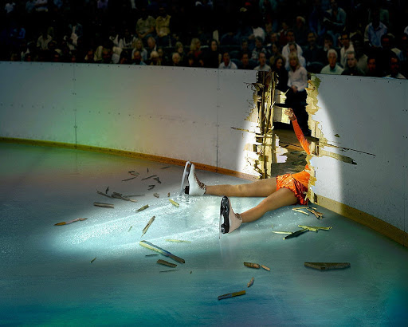
Requirement 1a
  Explain to your counselor the most likely hazards associated with skating and what you should do to anticipate, help prevent, mitigate, and respond to these hazards.

Slide 8
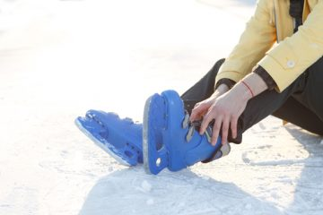
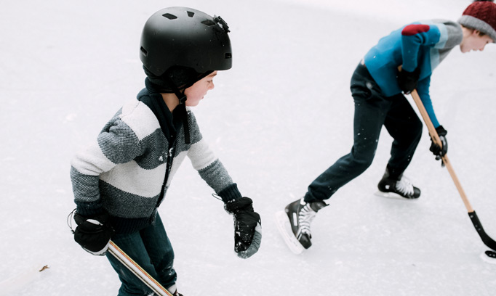
Hazards of Skating
Ankle Sprains & Fractures
The intense weight and pressure placed upon the ankles during skating activity makes them susceptible to sprains and fractures.
Head Injuries
When a loss of balance or control occurs, head injuries are a common and serious consequence. The ice surface is very dangerous as there is no cushion against impact. These skating injuries may include concussions or other traumatic brain injuries. Wear a helmet!

Slide 9
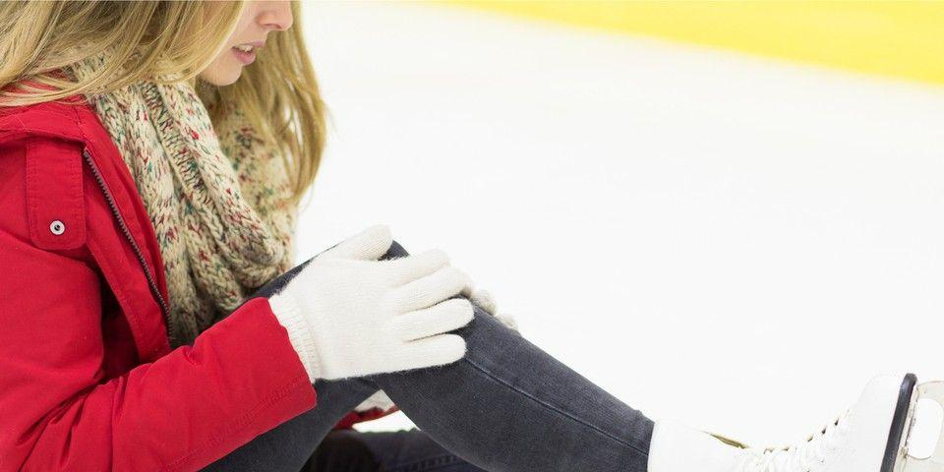
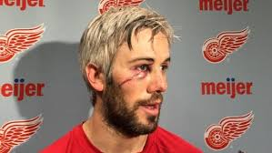
Hazards of Skating
(continued)
ACL Tears
The anterior cruciate ligament (ACL) runs diagonally through the middle of the knee and provides rotational stability. A traumatic injury, such as those commonly sustained during ice skating, can cause a tear of the ACL or surrounding menisci.
Lacerations
Sharp blades. Hard ice. Speed and precise movements. These combined factors put ice skaters at risk of lacerations of varying degrees of severity.

Slide 10
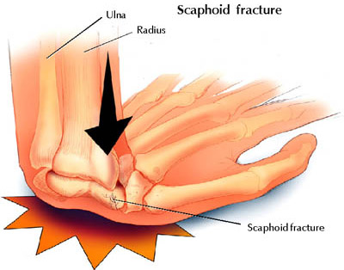
Hazards of Skating
(continued)
Hand and Wrist Injuries
When we experience a slip or fall, our immediate instinct is to put our hands out to catch ourselves--which is good, because it protects the more important head and face. But it can also result in serious injury to the hand or wrist from the force of the impact.

Slide 11
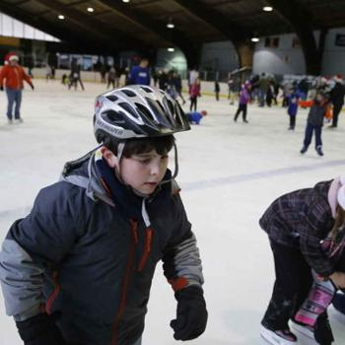
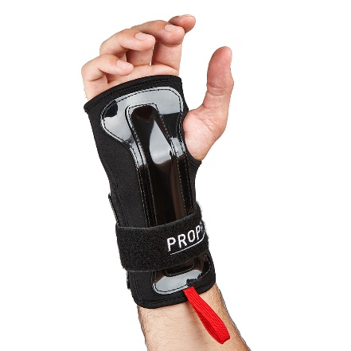
Skating Safety Tips
Proper Equipment
Many of the orthopedic skating injuries that are commonly suffered can be prevented by simply wearing proper equipment; that may include padding, helmets, and--of course--quality skates.
Proper Fit
Skates that do not fit properly contribute to a high number of skating injuries; they may cause stress to bones, muscles, and ligaments, as well as imbalance.

Slide 12
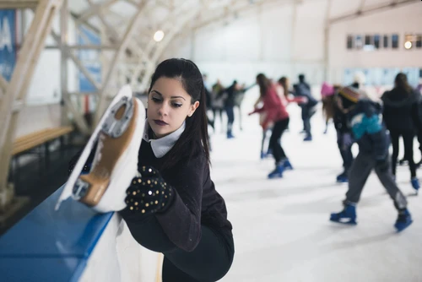
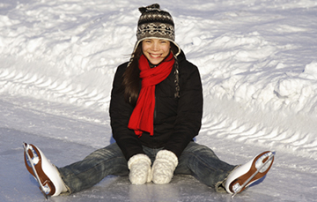
Skating Safety Tips
(continued)
Warm Up Thoroughly
Cold muscles and ligaments are more brittle and prone to tears and injury. Warming up can help to loosen your muscles, tendons, and ligaments and help to prevent tears.
Avoid Extreme Exposure
Wear adequately warm clothing--thick layers and a waterproof shell. And pay attention to changing weather. If you start to feel uncomfortable or chilled, it’s time to end your activity and return to warm shelter.

Slide 13
Requirement 1b
  Show that you know first aid for injuries or illnesses that could occur while skating, including hypothermia, frostbite, lacerations, abrasions, fractures, sprains and strains, concussions, blisters, heat-related reactions, and shock.

Slide 14
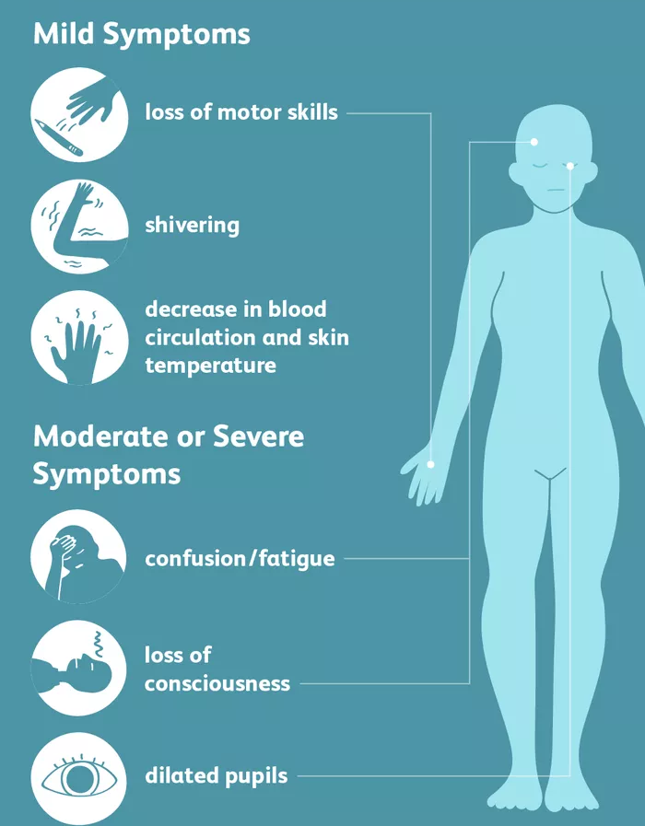
First Aid for Hypothermia
Gently remove wet clothing.
Replace wet things with warm, dry coats or blankets.
If further warming is needed, do so gradually.
  For example, apply warm, dry compresses to the center of the body — neck, chest and groin.

Slide 15
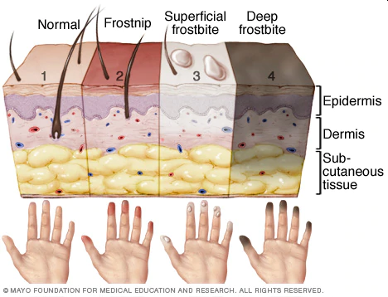
First Aid for Frostbite
Warm the frostbitten parts in warm (not hot) water for about 30 minutes.
Place clean cotton balls between frostbitten fingers and toes after they've been warmed.
Loosely wrap warmed areas with clean bandages to prevent refreezing.
Give acetaminophen or ibuprofen for pain.

Slide 16
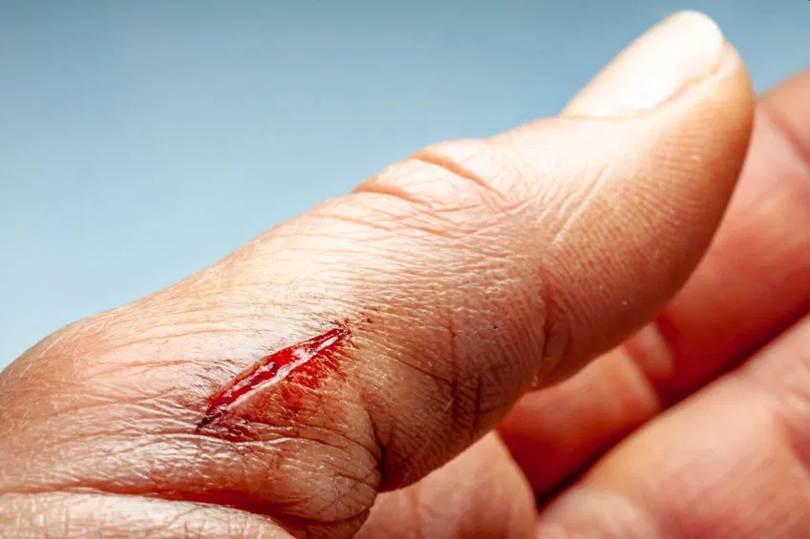
First Aid for Lacerations
Stop the Bleeding by apply direct pressure on the area if necessary.
Clean the area with warm water and gentle soap.
Apply an antibiotic ointment to reduce chance of infection.
For a minor laceration, remove the bandage after a couple of days to promote healing.
Call a health care provider if:
  The cut is deep or over a joint
  If the cut doesn't heal or shows signs of infection, including redness, swelling, pus, or excessive pain.

Slide 17
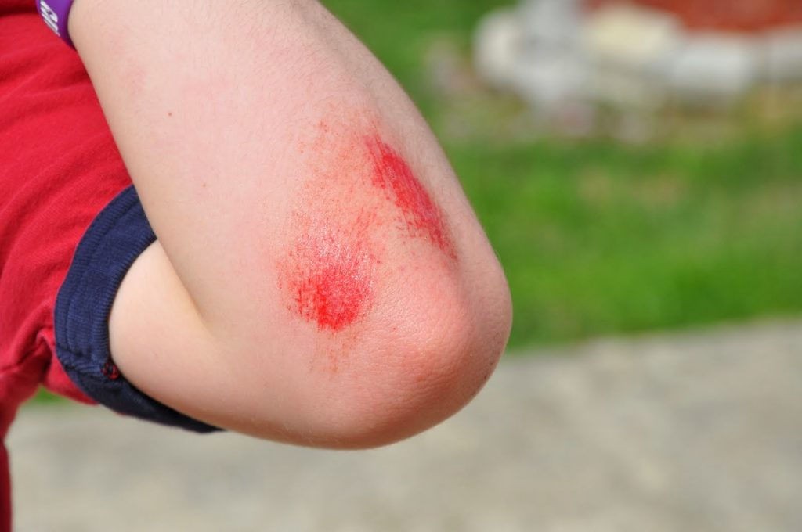
First Aid for Abrasions
Gently clean the area with cool to lukewarm water and mild soap.
Remove dirt or other particles from the wound using sterilized tweezers.
Apply an antibiotic ointment to reduce chance of infection.
Cover it with a clean bandage or gauze.
Gently clean the wound and change the ointment and bandage once per day.
Watch the area for signs of infection, like pain or redness and swelling.
See your doctor if you suspect infection.

Slide 18
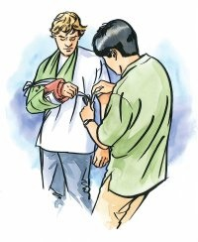
First Aid for Fractures
Stop any bleeding: If they’re bleeding, elevate and apply pressure to the wound using a sterile bandage, a clean cloth, or a clean piece of clothing.
Immobilize the injured area: If you suspect they’ve broken a bone in their neck or back, help them stay as still as possible. If you suspect they’ve broken a bone in one of their limbs, immobilize the area using a splint or sling.
Apply cold to the area: Wrap an ice pack or bag of ice cubes in a piece of cloth and apply it to the injured area for up to 10 minutes at a time.
Treat them for shock: Help them get into a comfortable position, encourage them to rest, and reassure them. Cover them with a blanket or clothing to keep them warm.
Get professional help: Call 911 or help them get to the emergency department for professional care.

Slide 19
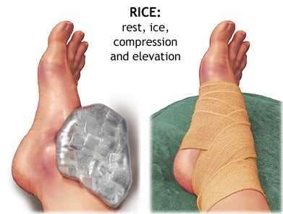
First Aid for Sprains and Strains
Rest the sprained or strained area. If necessary, use a sling for an arm injury or crutches for a leg or foot injury. Splint an injured finger or toe by taping it to an adjacent finger or toe.
Ice for 20 minutes every hour. Never put ice directly against the skin or it may damage the skin. Use a thin towel for protection.
Compress by wrapping an elastic (Ace) bandage or sleeve lightly (not tightly) around the joint or limb. Specialized braces, such as for the ankle, can work better than an elastic bandage for removing the swelling.
Elevate the area above heart level if possible.
Manage pain and inflammation with ibuprofen or acetaminophen
All but the most minor strains and sprains should be evaluated by a doctor.

Slide 20
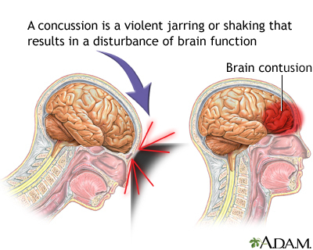
First Aid for Concussions
Immediately stop the activity.
Monitor the person for changes in symptoms.
Keep them calm and quiet.
Seek medical evaluation if symptoms persist or worsen.

Slide 21
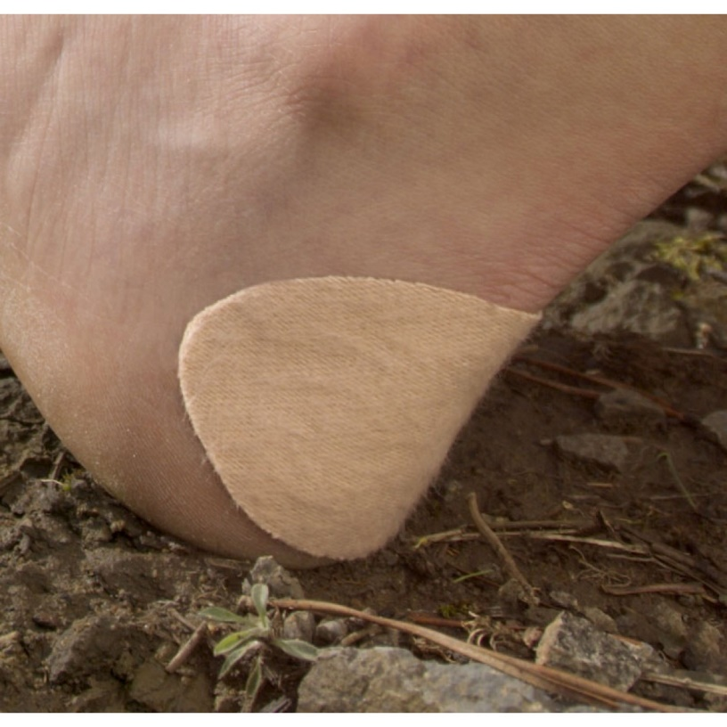
First Aid for Blisters
If a blister isn't too painful, try to keep it intact.
Unbroken skin over a blister may provide a natural barrier to bacteria and decreases the risk of infection.
Cover it with an adhesive bandage or moleskin.

Slide 22
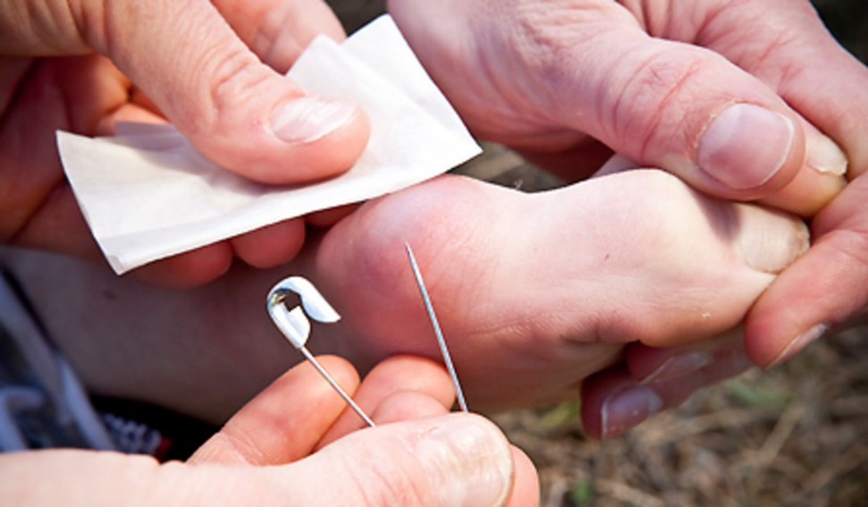
First Aid for Blisters
To relieve blister-related pain, drain the fluid while leaving the overlying skin intact.
Wash your hands and the blister with soap and warm water.
Swab the blister with iodine.
Sterilize a clean, sharp needle by wiping it with rubbing alcohol.
Use the needle to puncture the blister. Aim for several spots near the blister's edge. Let the fluid drain, but leave the overlying skin in place.
Apply an antibiotic ointment to the blister and cover it with a nonstick gauze bandage.
Follow-up care. Check the area every day for infection. Apply more ointment and a bandage.

Slide 23
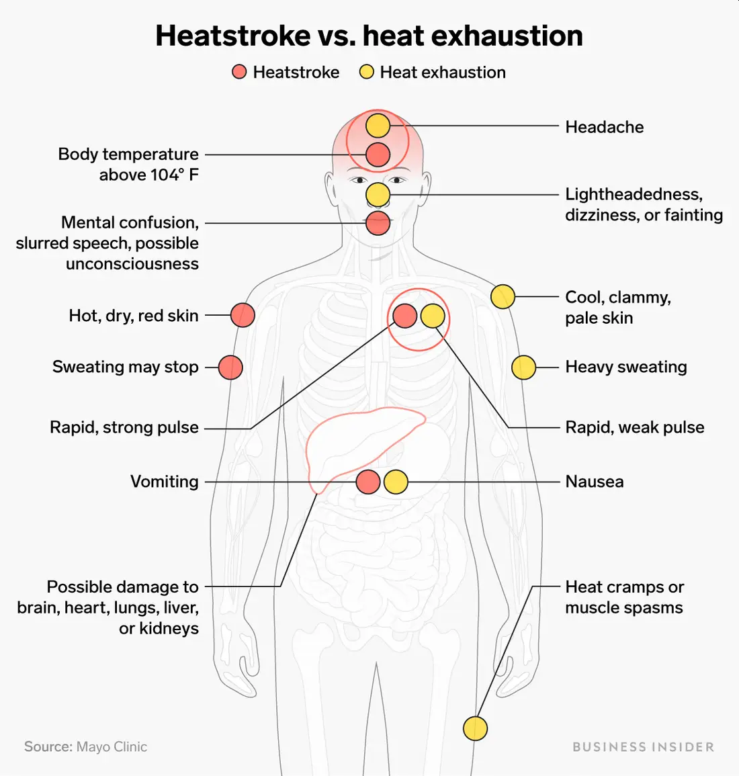
Symptoms of Heat Reactions

Slide 24
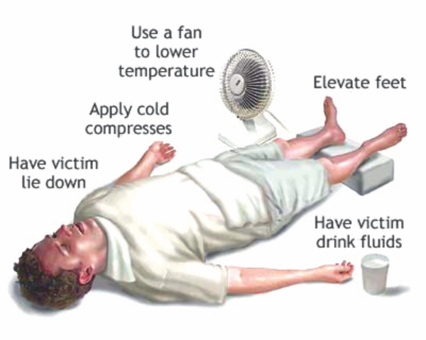
First Aid for Heat Related Reactions
For Heat Exhaustion:
Move the person out of the heat and into a shady or air-conditioned place.
Lay the person down and elevate the legs and feet slightly.
Remove tight or heavy clothing.
Have the person drink cool water or other nonalcoholic beverage without caffeine.
Cool the person by spraying or sponging with cool water and fanning.
Monitor the person carefully.
Contact a doctor if signs or symptoms worsen or if they don't improve within one hour.

Slide 25
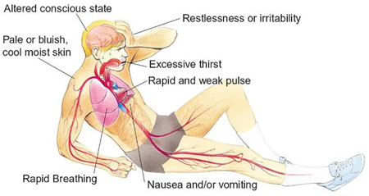
Symptoms of Shock

Slide 26
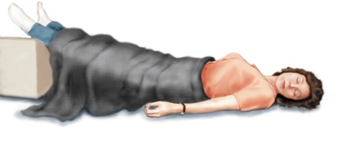
First Aid for Shock
Lay the person down and elevate the legs and feet slightly, unless you think this may cause pain or further injury.
Keep the person still and don't move him or her unless necessary.
Turn the victim’s head to one side if neck injury is not suspected.
Begin CPR if the person shows no signs of life, such as not breathing, coughing or moving.

Slide 27
Requirement 2a Ice Skating
Do the following:
  Give general safety and courtesy rules for ice skating. Discuss preparations that must be taken when skating outdoors on natural ice. Explain how to make an ice rescue.
  Discuss the parts and functions of the different types of ice skates.
  Describe the proper way to carry ice skates.
  Describe how to store skates for long periods of time, such as seasonal storage.

Slide 28
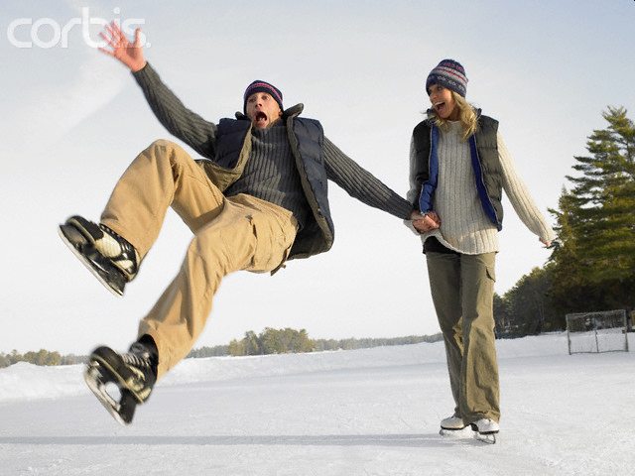
Safety and Courtesy Rules for Ice Skating
If you fall, get up quickly and avoid touching the ice with your hands as much as possible. Many accidents while skating involve cut fingers.
If you are about to fall, do not grab onto another skater. Try to lower your arms and bend your knees to lower your center of gravity.

Slide 29
Safety Rules at Ice Rinks
No eating or drinking on the ice.
No playing tag, follow-the-leader, or crack-the-whip.
No cutting across the path of other skaters.
No speeding.
No skating against the direction of skating traffic.
No roughhousing or shouting.
Limit skating while holding hands to three skaters.
Skates may be worn off the ice only in those rink areas covered with protective flooring.
Don’t drop anything on the ice that could cause another skater to trip and fall. If you do drop something, pick it up quickly.

Slide 30
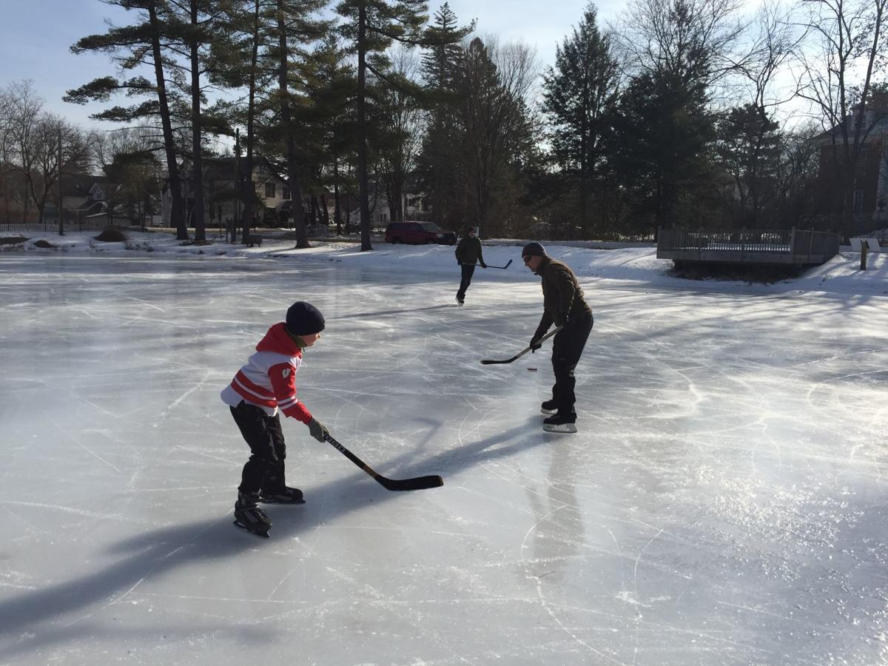
Preparations for Skating on Natural Ice
Never skate alone.
Always have a responsible adult test ice before skating.
Ice must freeze to a uniform thickness of 4 inches before it is safe for skating.
Ice formed over swift water is always unsafe.
Always carry emergency equipment.
Always prepare for the worst.

Slide 31
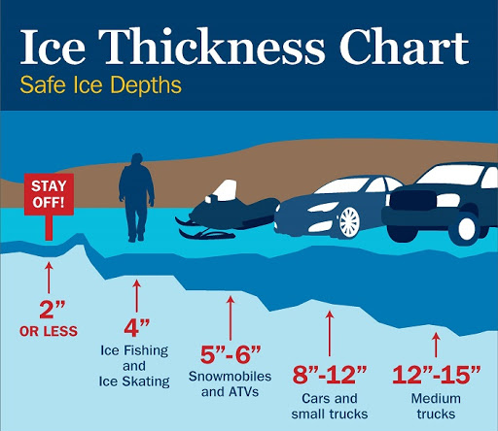

Slide 32
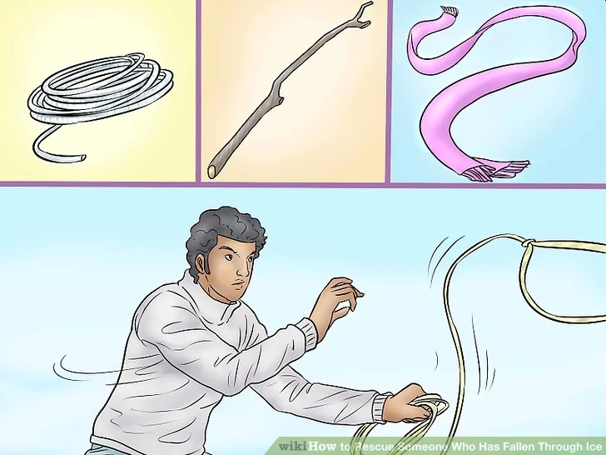
How to Make an Ice Rescue
Preach - Encourage the victim to keep trying to stay afloat and not to give up. You're letting him know you're there and you're trying to help, but you're going to do this safely.
Reach - Reach out to the victim without leaving shore. Use ladders, poles or anything handy to reach the victim.
Throw - Throw something to the victim and pull him/her out. A throw rope is made for this purpose, but you can also use jumper cables, garden hoses, or whatever is handy and strong enough to pull the victim from the water.

Slide 33
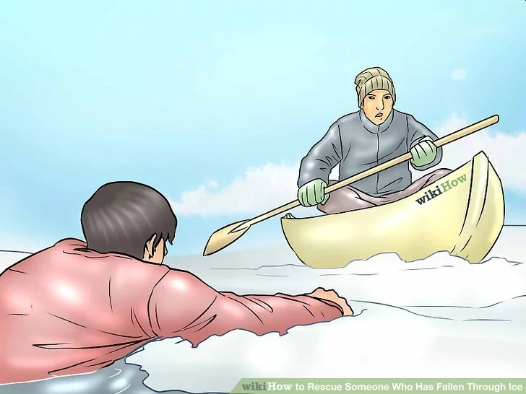
How to Make an Ice Rescue
Row - Take something to float on and push a flotation device out to the victim. If the ice breaks again, you'll be floating on the cold water underneath instead of swimming in it.

Slide 34
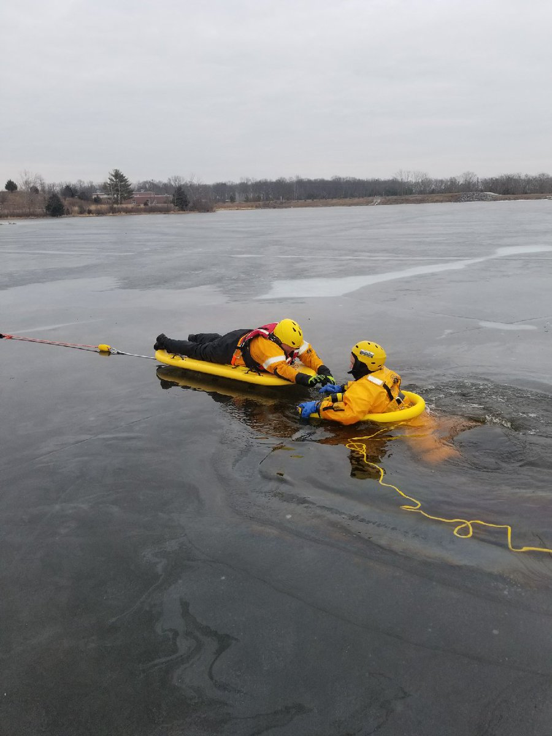
How to Make an Ice Rescue
Go - it's best if the professionals can do it. We all know that the clock is ticking as long as the victim is in the icy cold water. If you must approach the hole in the ice, don't walk upright. Lay down and slide up to the edge. Your body weight will be spread over a larger surface area, making the ice less likely to break more. Combine going with reaching; use whatever you can to reach the victim without getting too close to the hole in the ice.

Slide 35
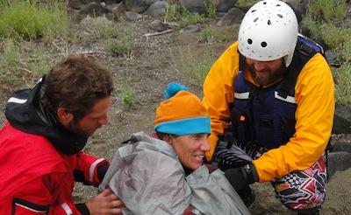
How to Make an Ice Rescue
Treat Hypothermia - Falling through ice to the cold water below is a truly life-threatening situation and requires quick action. It only takes a minute or two before the victim becomes too weak to escape the water on his own. Once back on the ice, the victim is still in danger of falling through again or of succumbing to hypothermia.

Slide 36
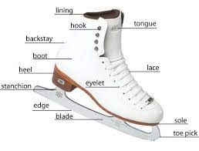
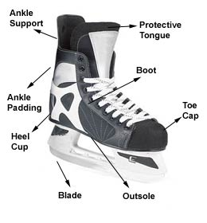
Parts and
Functions of Figure and Hockey Skates
The boot is the part that supports the foot.
Figure skates feature a sole, often made of wood and/or leather. This sole has a raised heel at the back of the boot.
The insides of boots are padded to offer comfort to the skater.
The tongue provides comfort over the top of the foot, as well as protection.
Laces are fed through holes in the boot material up to the ankle level on the skaters foot, and then are attached by hand by looping the laces around hooks on the upper part of the boot. This allows the skater to more-or-less stiffly lace their boots up, depending on the amount of support they desire.
The blade is attached onto the boot's heel and toe by a series of screws (figure skates) or the outsole (hockey skates). Blades are made of stainless steel to prevent corrosion.

Slide 37
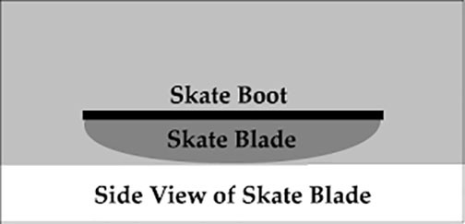
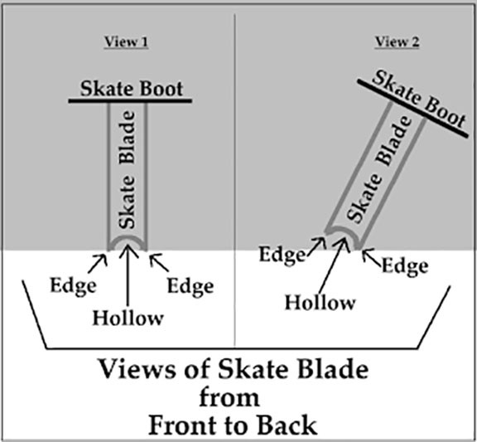
Skate Blades
The Rocker or Profile
  The bottom of the blade is curved, like a rocker, and only part of the blade is on the ice at any one time.
The Edges
  Each blade actually has two edges, with a hollow in the middle.

Slide 38
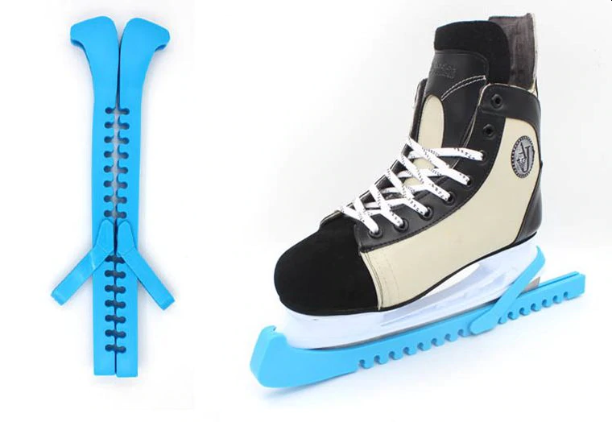
How to Carry and Store Ice Skates
When transporting your skates to and from the rink, cover your blades with a blade cover or store in a boot bag.
When you get home, remove the skates from your bag and allow them to air dry.
Undo the laces and open your boots wide to dry and protect your skates from developing mildew.
When storing your skates, treat your boots with a leather protector, making sure the blades are sharpened, tighten blade screws, and replace worn laces.

Slide 39
Requirement 2b Ice Skating
Do the following:
  Skate forward at least 40 feet and come to a complete stop. Use either a two-foot snowplow stop or a one-foot snowplow stop.
  After skating forward, glide forward on two feet, then on one foot, first right and then left.
  Starting from a T position, stroke forward around the test area, avoiding the use of toe picks if wearing figure skates,

Slide 40
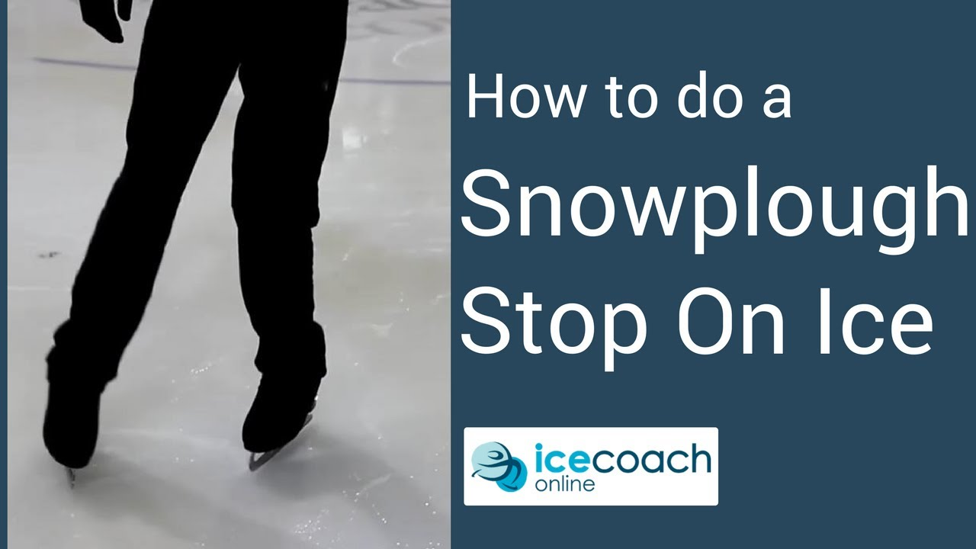
Snowplow Stops
Click image for video

Slide 41
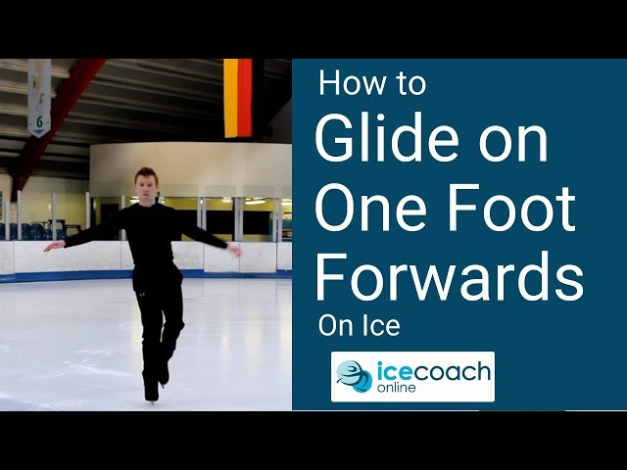
Gliding Forward
Click image for video

Slide 42
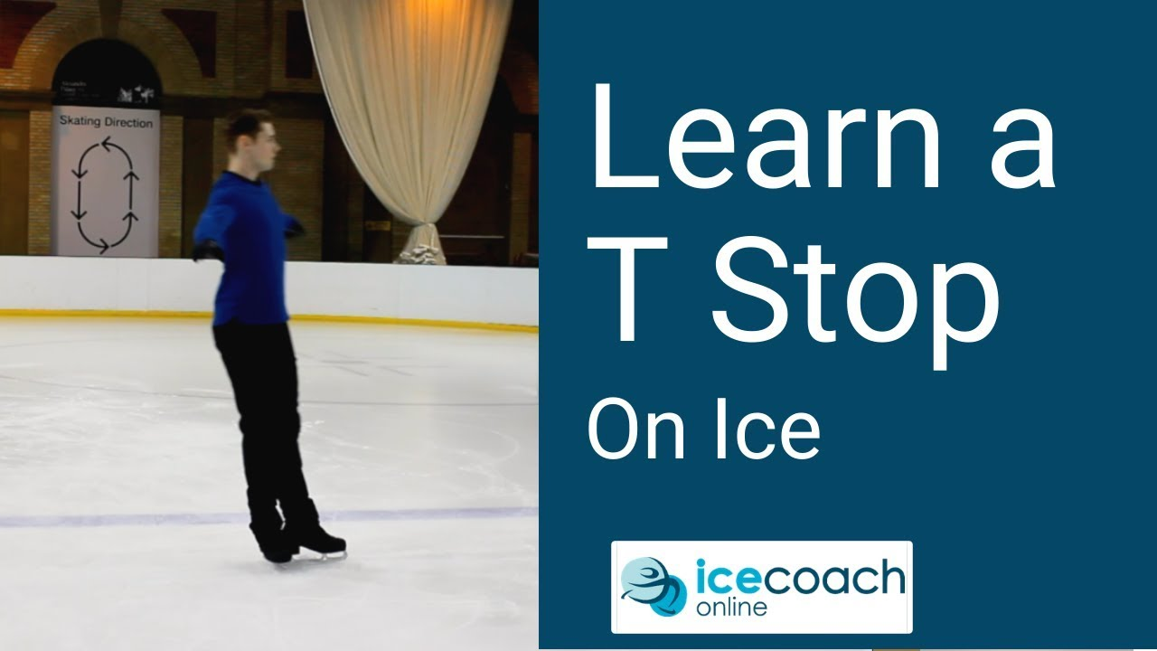
T Stop
Click image for video

Slide 43
Requirement 2c Ice Skating
Do the following:
  Glide backward on two feet for at least two times the skater's height.
  Skate backward for at least 20 feet on two skates.
  After gaining forward speed, glide forward on two feet, making a turn of 180 degrees around a cone, first to the right and then to the left.

Slide 44
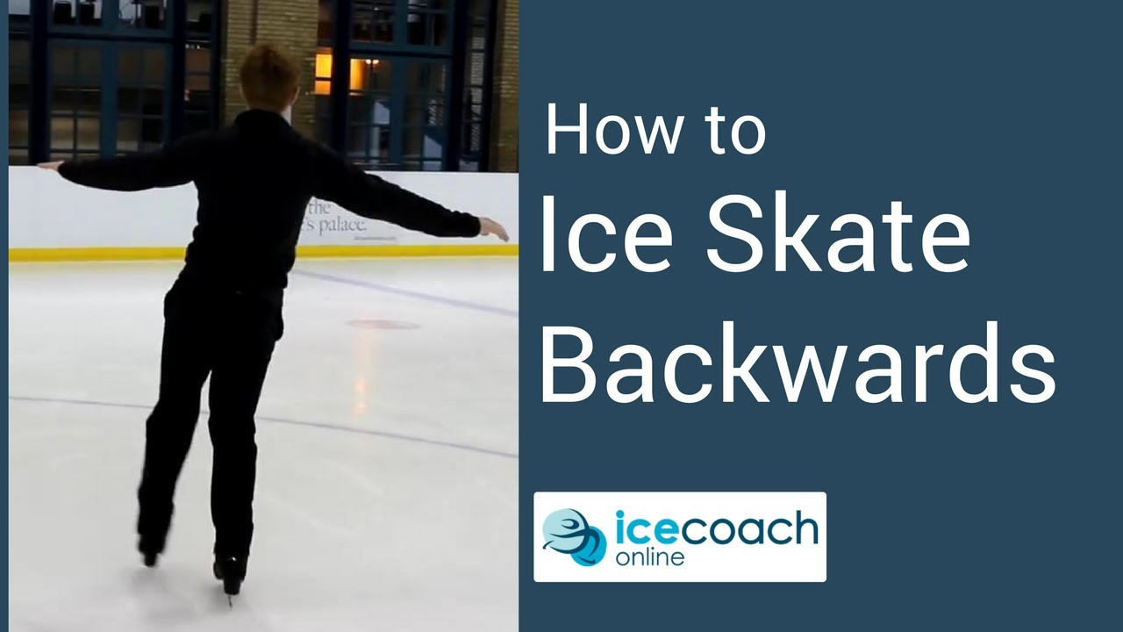
Backwards Skating
Click image for video

Slide 45
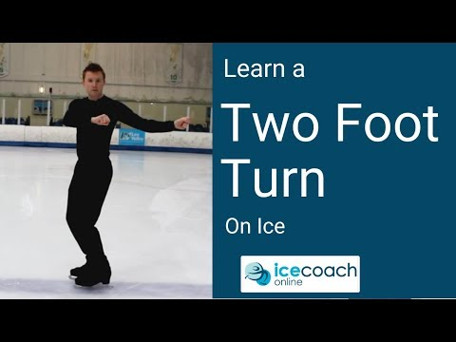
Turning
Click image for video

Slide 46
Requirement 2d Ice Skating
Do the following:
  Perform forward crossovers in a figure eight pattern.
  Explain to your counselor the safety considerations for running or participating in an ice skating race.
  Perform a hockey stop.

Slide 47

Crossovers in a Figure Eight
Click image for video

Slide 48
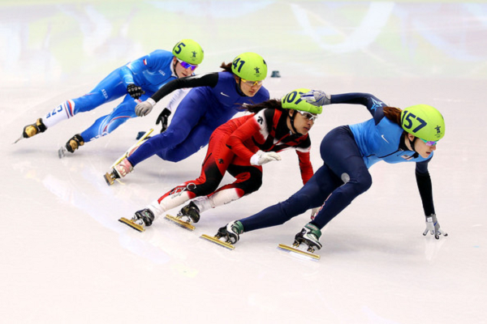
Ice Skating Races
Speed skating is a competitive form of ice skating in which the competitors race each other in travelling a certain distance on skates.
Required safety equipment used in Speed Skating include a protective helmet, cut proof skating gloves, knee pads and shin pads, neck guard and ankle protection.
Protective eye wear should also be worn.
This equipment is to protect skaters from falls, collisions, and from each others blades during falls.

Slide 49
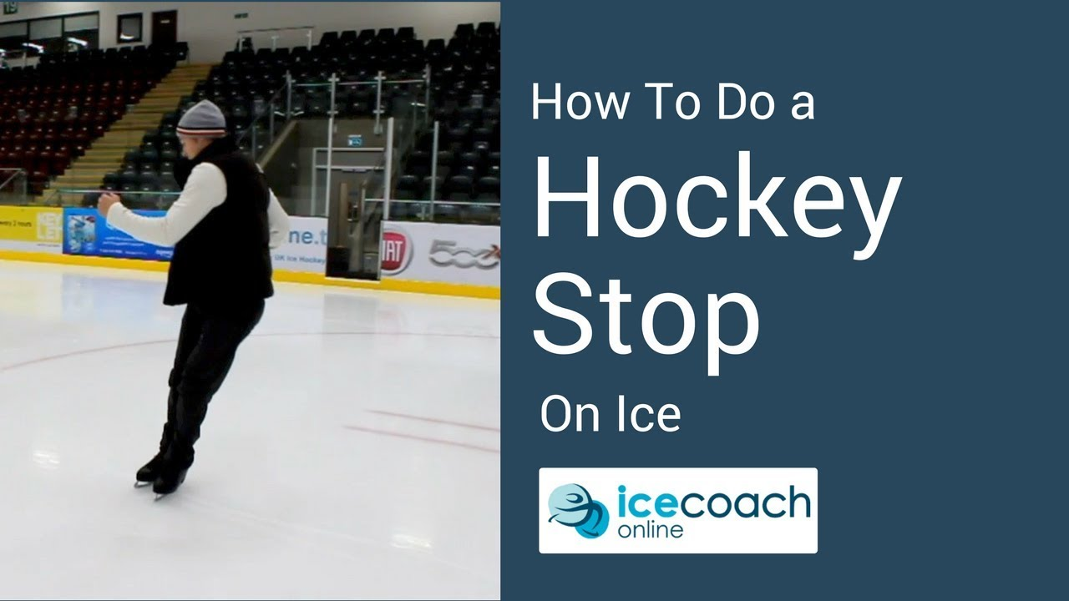
Hockey Stop
Click image for video

